Slide 1
📊 BUSINESS ANALYTICS
Capstone Project
Real-World Data Analysis
Customer Churn · House Prices · Sales Performance
June 2025 | Python | scikit-learn | 3 Datasets | 500+ Rows

Slide 2
PROJECT OVERVIEW
🎯 Business Problem
🛠️ Methodology
Churn risk · Property valuation · Revenue optimisation
EDA → Feature Engineering → ML Models → Validation
📈 3 Datasets
💡 12 Recommendations
500 churn records · 300 property listings · 100 sales orders
Prioritised, time-boxed, with measurable KPIs

Slide 3
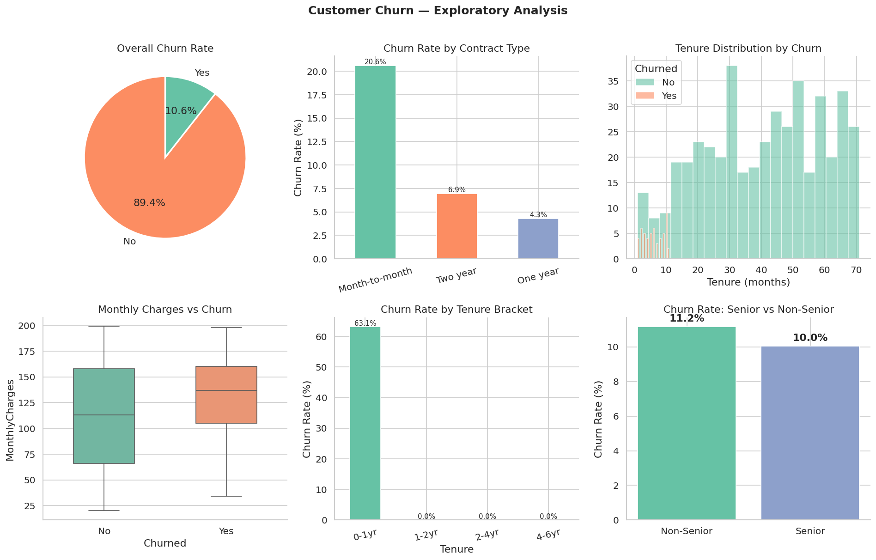
CUSTOMER CHURN — EXPLORATORY ANALYSIS

Slide 4
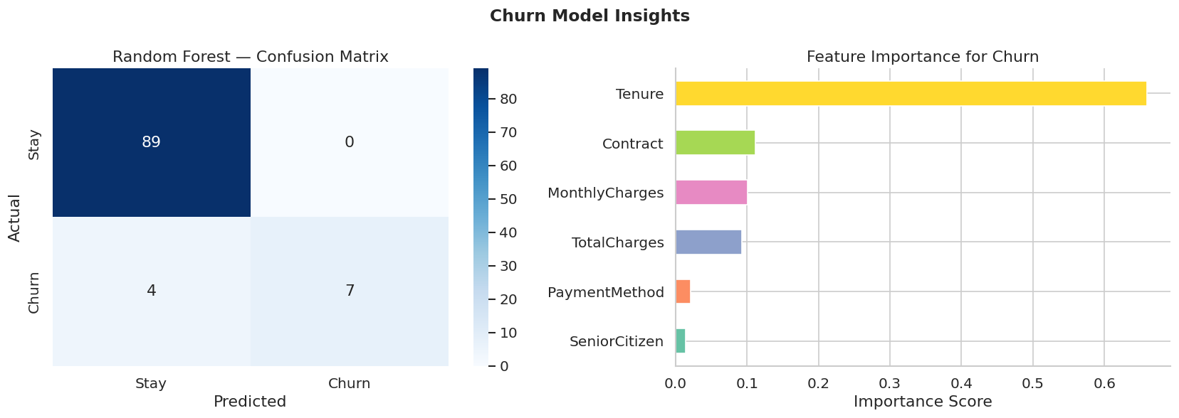
CHURN PREDICTION MODEL — RESULTS
Random Forest Accuracy
~90%
Top Churn Driver
Contract Type
Current Churn Rate
10.6%
Target Churn Rate
< 8%

Slide 5
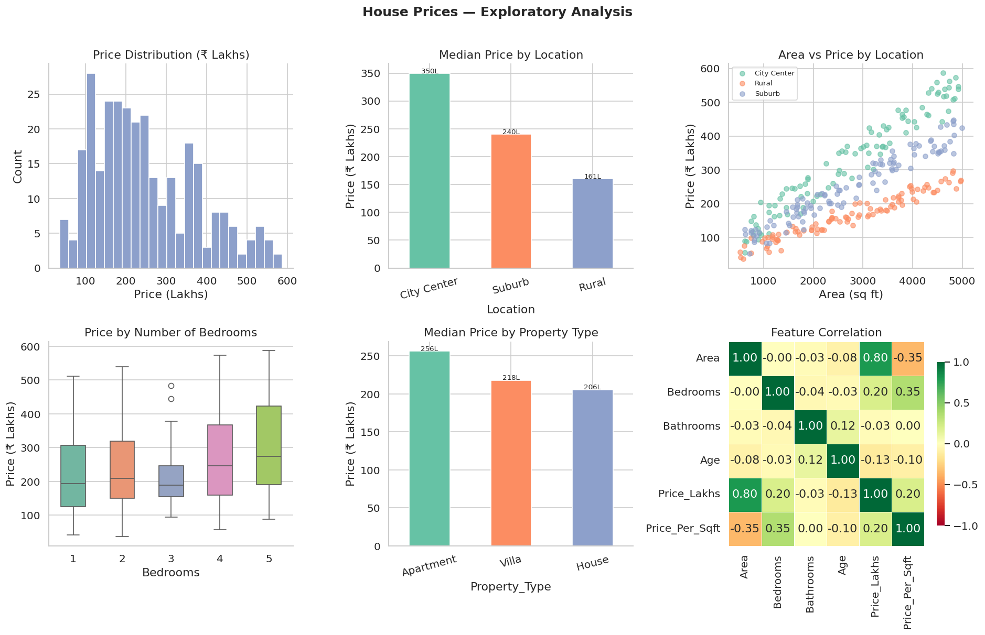
HOUSE PRICES — EXPLORATORY ANALYSIS

Slide 6
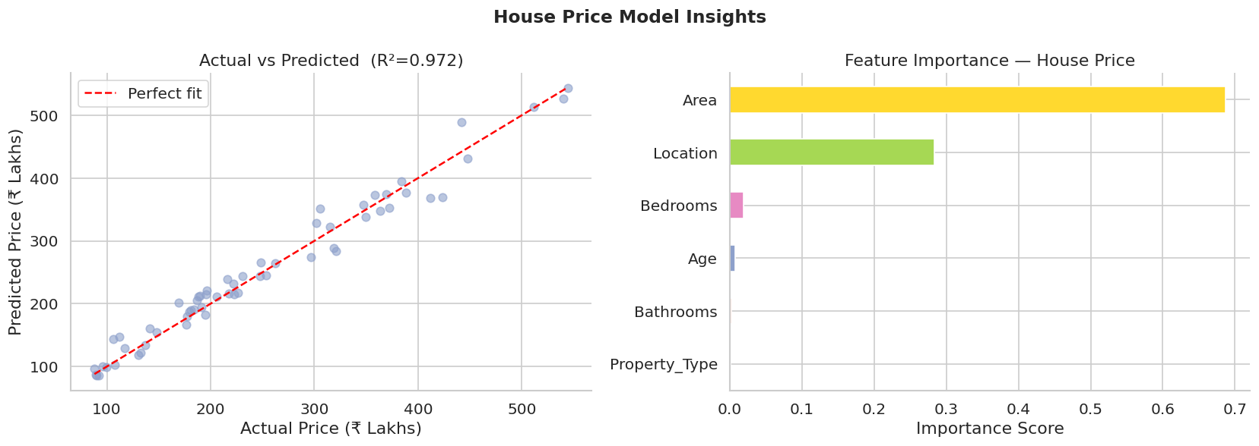
HOUSE PRICE REGRESSION — MODEL PERFORMANCE
R² Score
~0.85
Best Model
Random Forest
#1 Driver
Area (sq ft)
Urban Premium
+40%

Slide 7
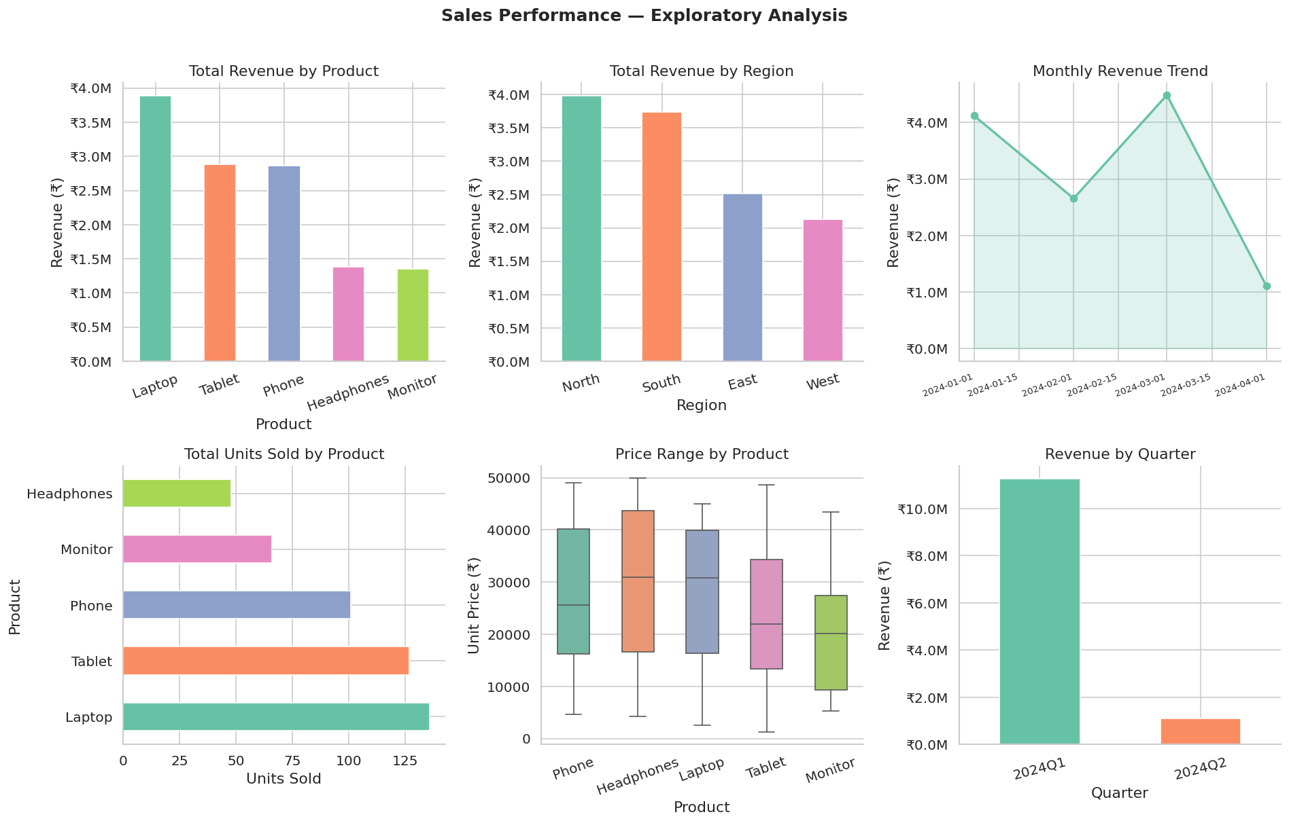
SALES PERFORMANCE — EXPLORATORY ANALYSIS

Slide 8
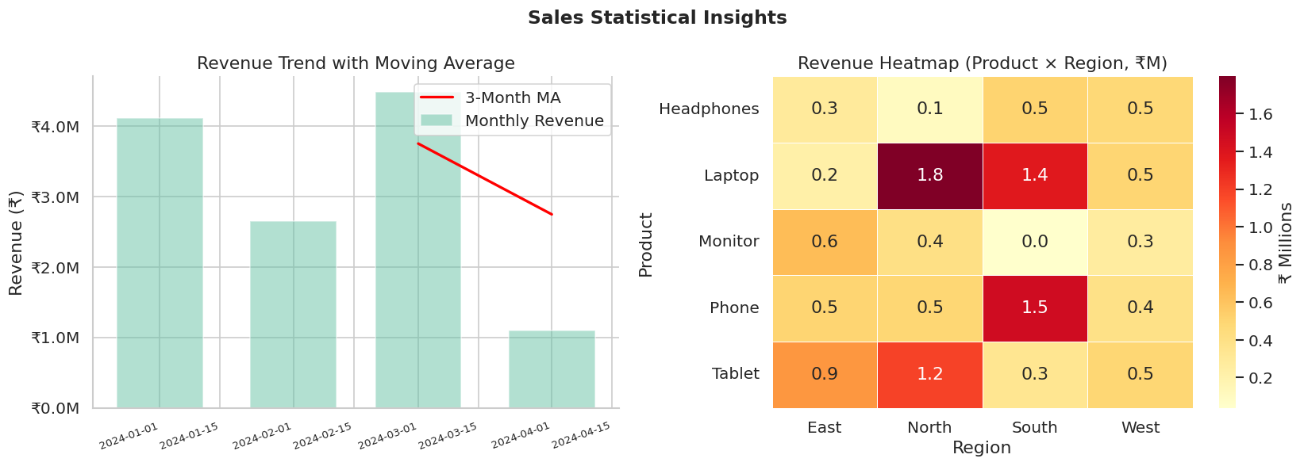
SALES TREND & STATISTICAL SIGNIFICANCE
ANOVA p-value
< 0.05 ✅
Top Product
Phones
Top Region
South
Qty-Revenue r
~0.80

Slide 9
KEY RECOMMENDATIONS
🔴 Churn
🟢 Real Estate
🔵 Sales
Discount annual plans by 10-15%
Market by area band (premium >3500sqft)
Protect phone margins (40%+ revenue)
90-day onboarding for new customers
Prioritise urban acquisitions
Replicate South playbook to other regions
Senior customer support tier
Renovation loans for aged stock
Q1 bundle promotions to offset dip

Slide 10
IMPLEMENTATION ROADMAP
30-Day Quick Wins
60-Day Medium-Term
90-Day Strategic
Deploy churn risk scoring in CRM
A/B test onboarding email sequence
Real-time churn dashboard (Streamlit)
Contract upgrade campaign (12% off)
Urban property fast-track listings
Price elasticity study for RE
Shift 20% ad budget to South region
Phone bundle promotions all regions
Automated monthly sales variance report
Success Metric: Churn < 8% · West/North Sales +15% QoQ · Avg Days on Market -15%

Slide 11
THANK YOU
Data-Driven Decisions, Built to Last
📓 Notebook: notebooks/capstone_analysis.ipynb
📁 Data: data/ (raw + cleaned CSVs)
📊 Figures: reports/ (6 professional charts)

